Slide 1

Capstone Project
EDA on Hotel Booking
Analysis
by-Gaurav rana

Slide 2
Content
project summary
Problem statement
Understand and collect data
Clean and manipulate data
Data visualization/EDA

Slide 3
Project summary
We have been provided a hotel booking dataset and we have to observe ,make changes in the data which means we have to remove null and duplicate values from our dataset.
Removing those values is an important part to get the proper or correct result.
We have to perform EDA i.e Exploratory Data Analysis which means to look at the data before making any assumptions.
EDA also helps to find errors, identify patterns within our dataset.

Slide 4
Problem statement
For this project we will be analyzing Hotel Booking data. This data set contains booking information for a city hotel and a resort hotel, and includes information such as when the booking was made, length of stay, the number of adults, children, and/or babies and many more.
The main objective behind this project is to explore and analyze data to discover important factors that govern the bookings and gain insights about the hotel business.

Slide 5
We have divide the work in 3 parts:
Understand and collect data
Clean and manipulate data
Exploratory Data Analysis(EDA)

Slide 6
Understand and collect data
After collecting data we came to know that our dataset contains 119390 rows and 32 columns.
About the data from the dataset:
Hotel:- ‘resort hotel ‘and ‘city hotel’
is_canceled :- Value indicating if the booking was canceled (1) or not (0)
meal :- Type of meal booked.
country :- Country of origin.
deposit_type :- No Deposit, Non Refund , Refundable.
agent :- ID of the travel agency that made the booking
adr :- Average Daily Rate as defined by dividing the sum of all lodging transactions by the total number of staying nights
These are some of the columns from our dataset.

Slide 7
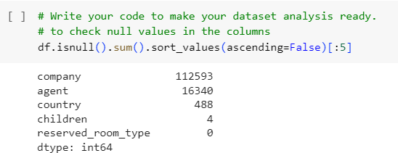
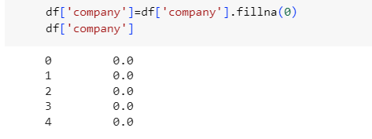
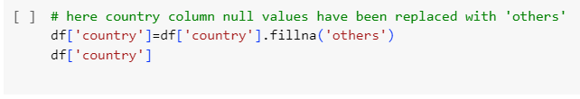
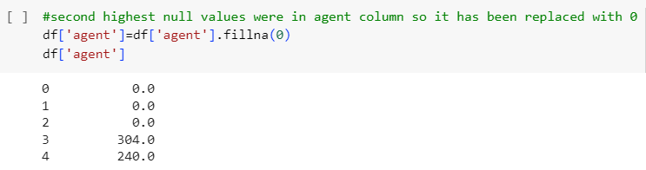
Clean and manipulate data
Checking of null values in dataset is done and those null values are replaced with value 0.
From the image it is shown that four
columns have null values so it will be replaced
with value 0 or text ‘others’ which can be seen
in other images.

Slide 8
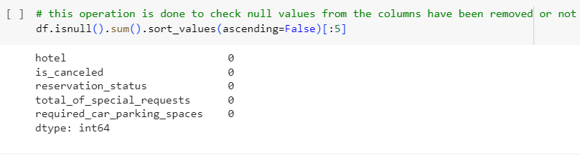
To check whether the null values have been replaced or not the operation is performed which is shown in the picture.
From the picture it is confirmed that our data now do not have null values.

Slide 9
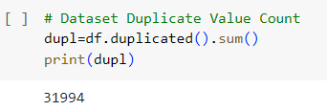

Now we have to check any duplicate values in our dataset.
From the picture shown we have used the sum function to calculate the
number of duplicate values in our data which is 31994.
We have to remove those duplicate values otherwise it will affect our
result.
The operation done in above picture allows us to delete those duplicate values.
Now we will create two new columns to calculate total days stay in hotel by the customers and total people visited the hotel.

Slide 10
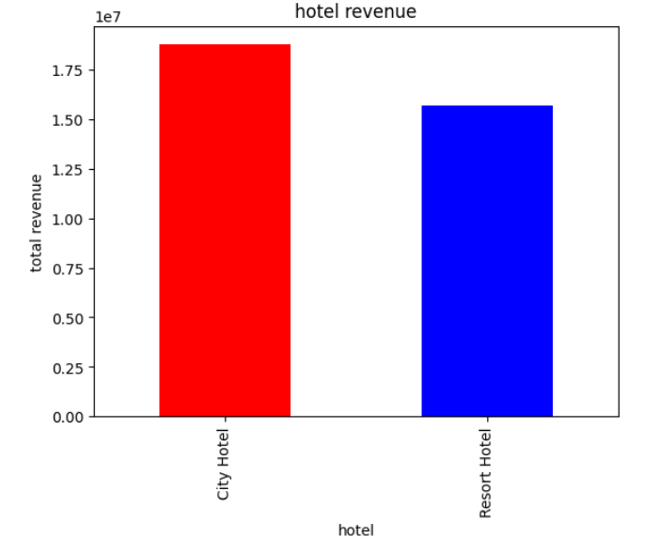
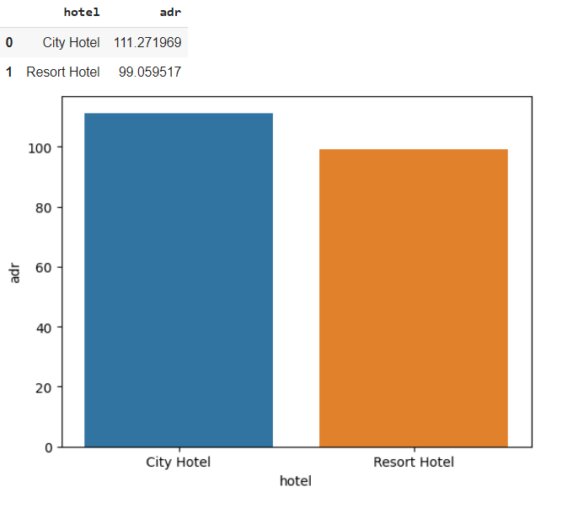
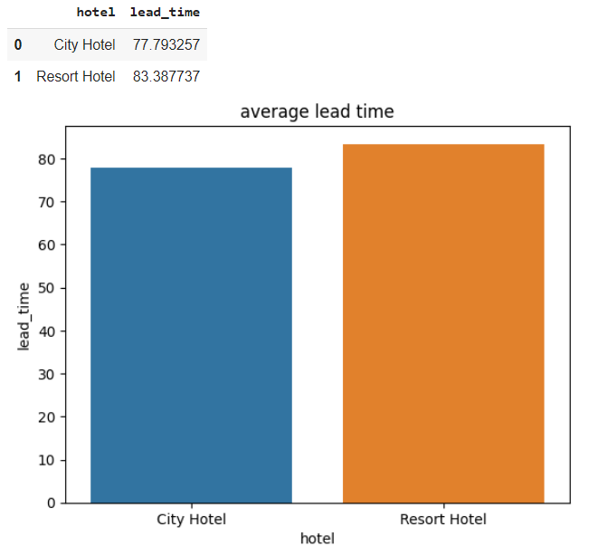
Data visualization/EDA
Conclusion:
City hotel generates more revenue as compared to resort hotel.
Average adr of city hotel is more than resort hotel.
adr is average daily rate
Average lead time of resort hotel is slightly more than the city hotel.

Slide 11
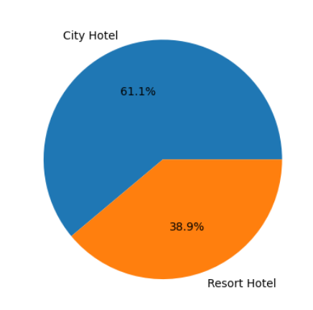
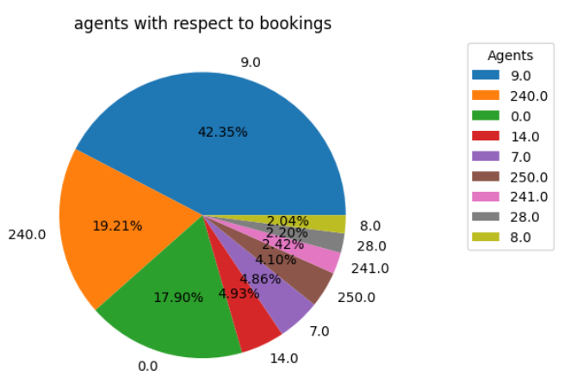
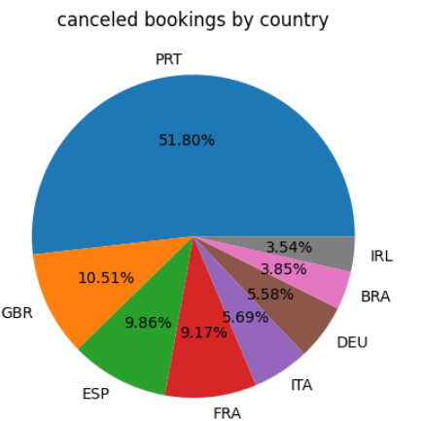
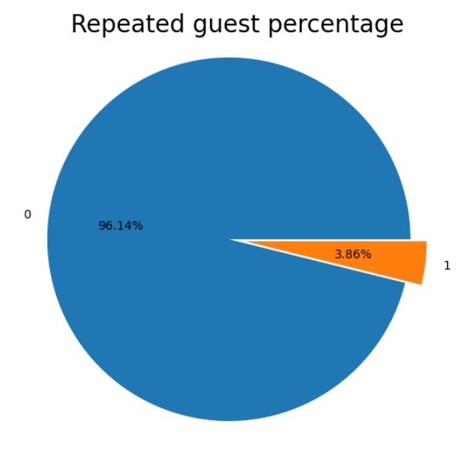
Conclusion:
City hotel is most preferred as compared to the resort hotel.
Agent number 9 has done the maximum number of bookings.
The maximum number of bookings cancelled were done by the Portuguese people.
Repeated guests are very less i.e 3.86% only.

Slide 12
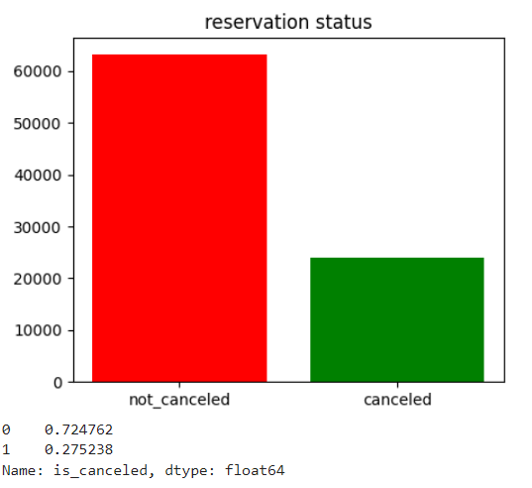
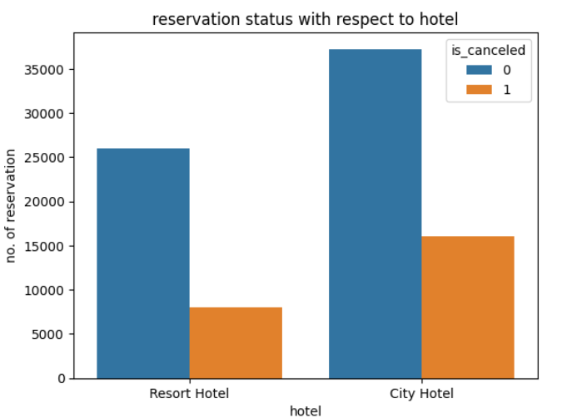
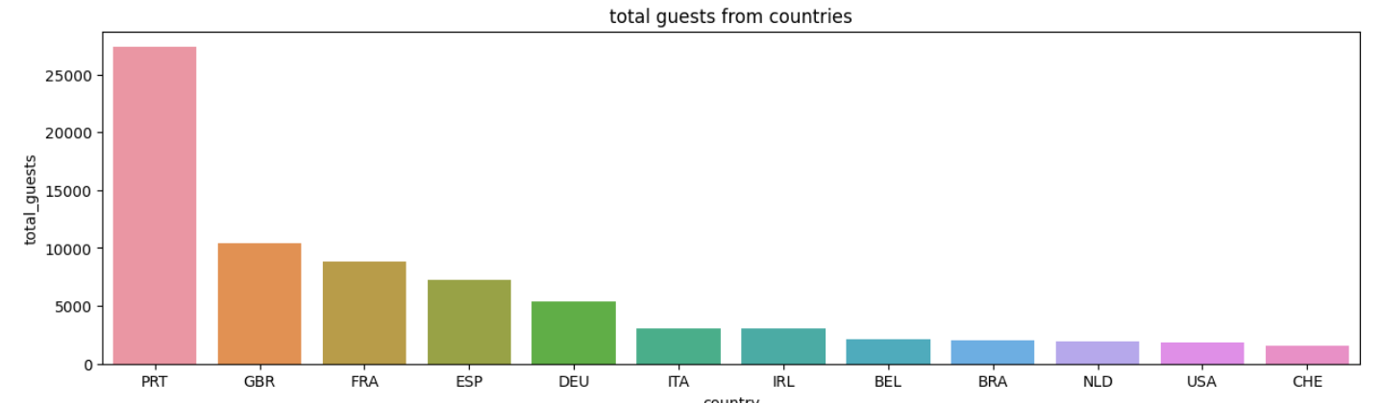
Conclusion:
Booking cancellation is only 27.5%
The maximum number of bookings is done by the city hotel and maximum number of cancellations is also done by city hotel.
The customers booking the hotels are maximum from the country Portugal.

Slide 13
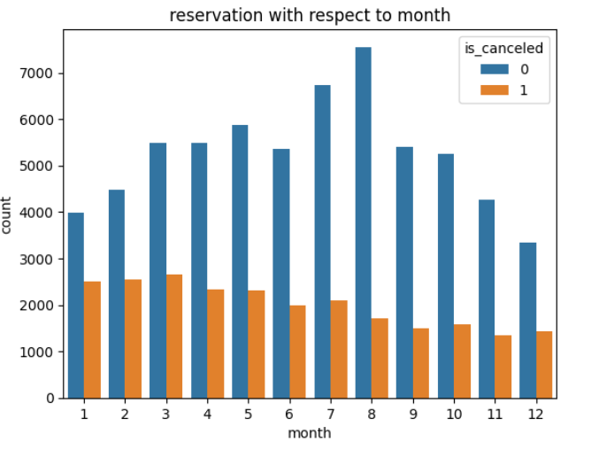
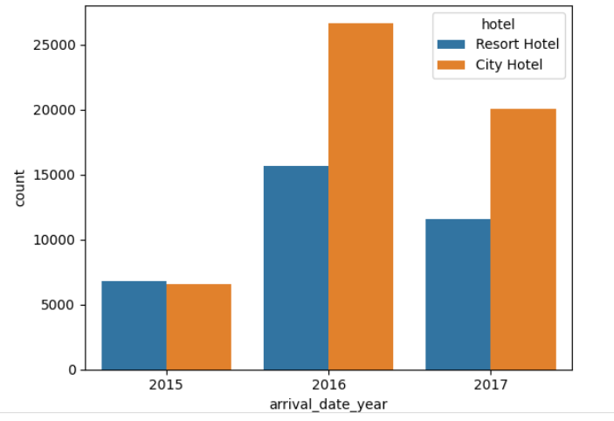
Conclusion:
The most number of bookings is done in 8th (August) month and the maximum number of cancellations is done in 3rd(March) month.
Most number of bookings is done in 2016 by city hotel and resort hotel also have max. number of bookings in 2016.

Slide 14
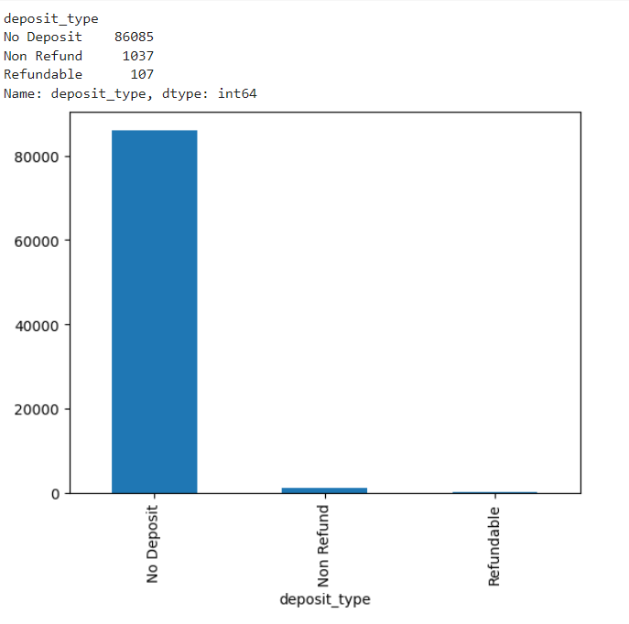
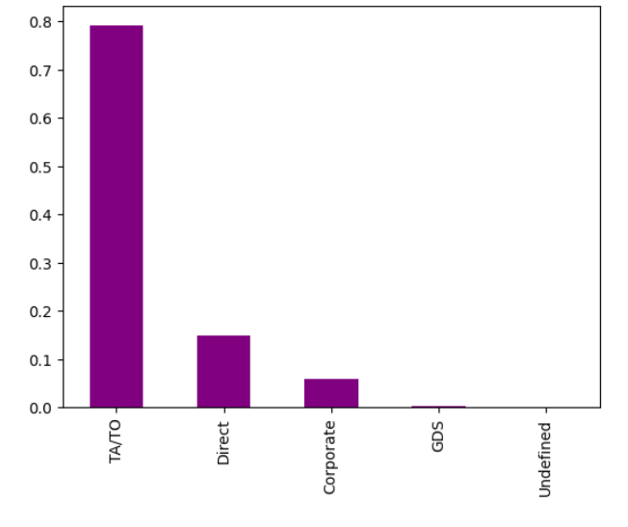
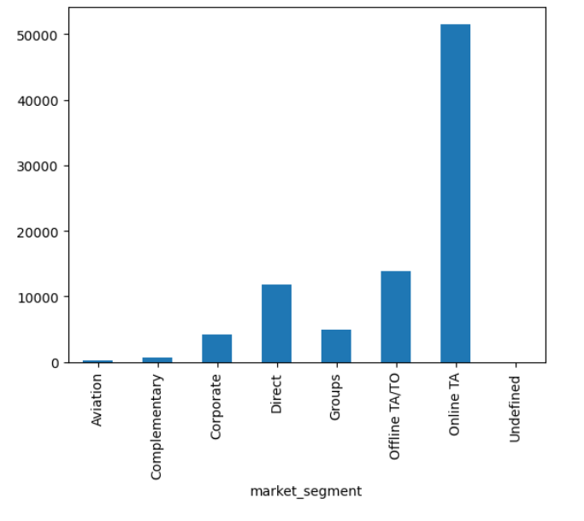
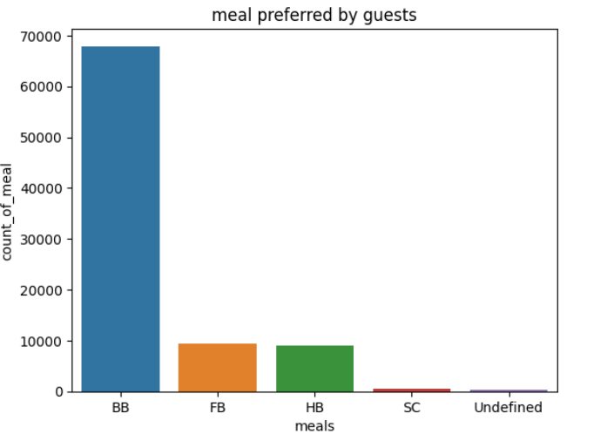
Conclusion:
Most number of booking is done through no deposit type where guest don’t have to pay any amount during booking.
The most bookings were done through TA/TO distribution channel followed by Direct channel.
In market segment Online TA has done the maximum number of bookings.
BB(bed and breakfast) is the most preferred meal by the guests.

Slide 15
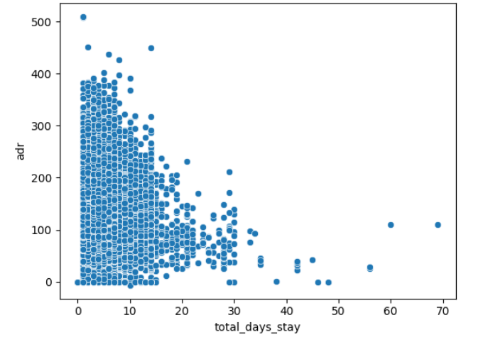
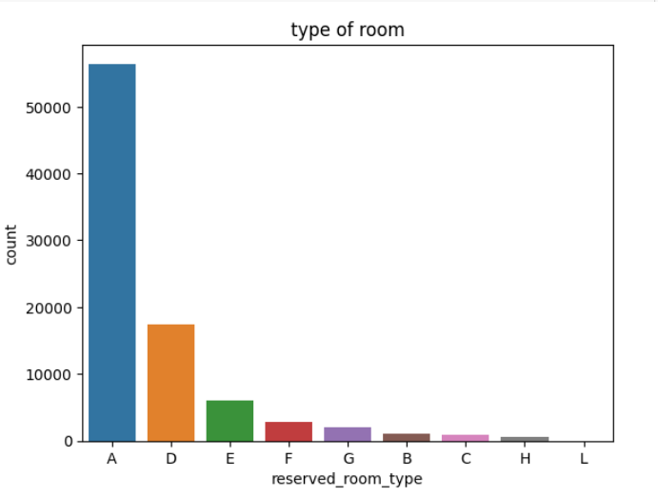
Conclusion:
We can see that adr is less when the total_days_stay increases.
From the type of room chart it can be seen that the most preferred room is A type.

Slide 16
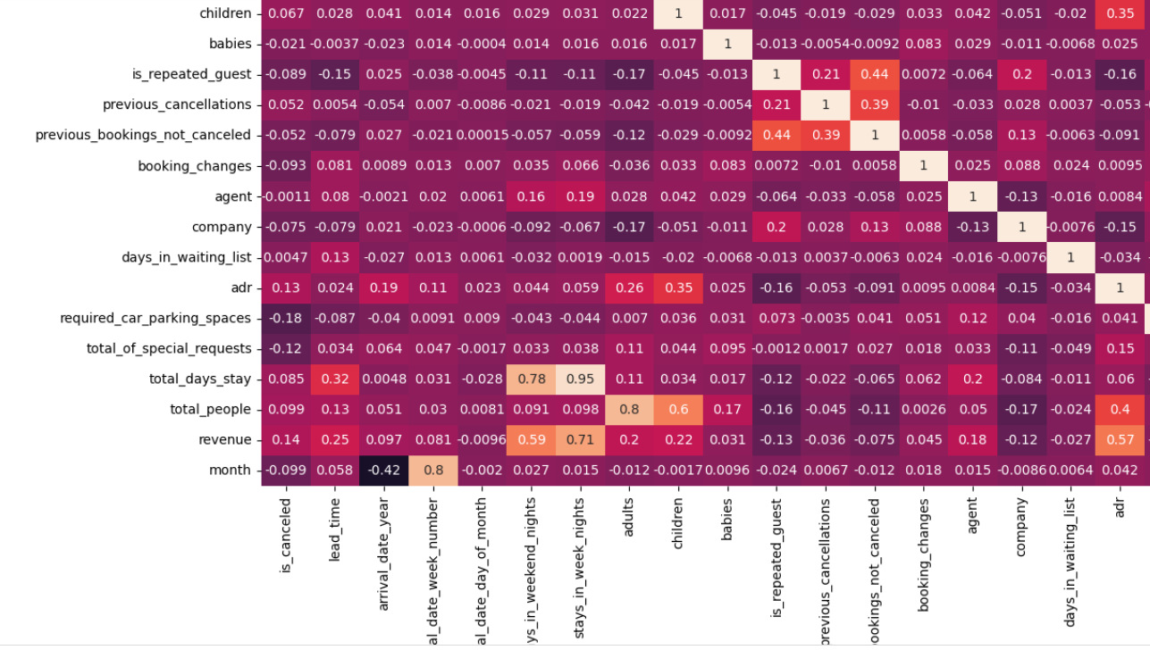
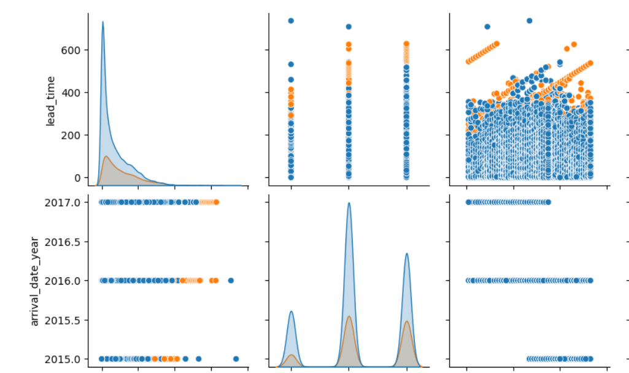
Conclusion:
In heatmap it can be seen that revenue is positively corelated with stays in week nights and stays in weekend nights.
Next image is of pair plot which allows us to plot pairwise relationships between variables within a dataset.

Slide 17
Thank you

